Slide 1
Maryland Avenue, NE Road Diet Project from 2nd St., NE to 14th St., NE D.C. Contract Number: DCKA-2018-C-0095
Federal-Aid Number: STP-2018(023)

Slide 2
Team
District Department of Transportation
Cube Root Corporation Construction Manager Nandlal Gevaria
Fort Myer Construction
Cesar Casanova
Nspiregreen LLC
Public Outreach Coordination
McNeill Tylor
Project Manger
Abdullahi Mohamed

Slide 3
Project Process
Planning
2011-2015
Design
2016-2017
Construction
2019-2021

Slide 4
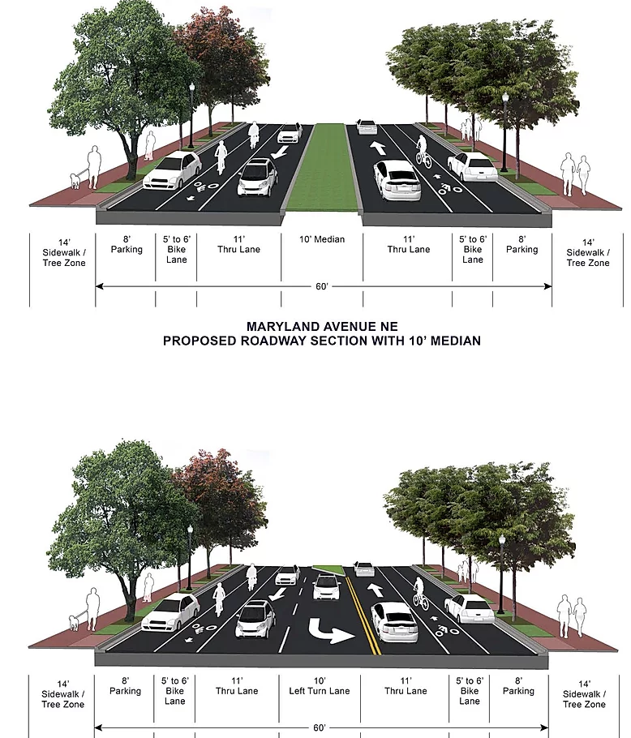
About The Project
The Maryland Avenue NE project will:
Improve safety and access for bikes, pedestrians, and cars on the corridor between 2nd Street and 14th Street NE
Includes new lighting, traffic signals, high visibility crosswalks, brick sidewalks and granite curb, traffic calming, shorter crossing distances for pedestrians and new bike lanes
Decrease the road width to achieve these systemic improvements

Slide 5

About the Project: Project Corridor

Slide 6
About the Project: Project Corridor

Slide 7
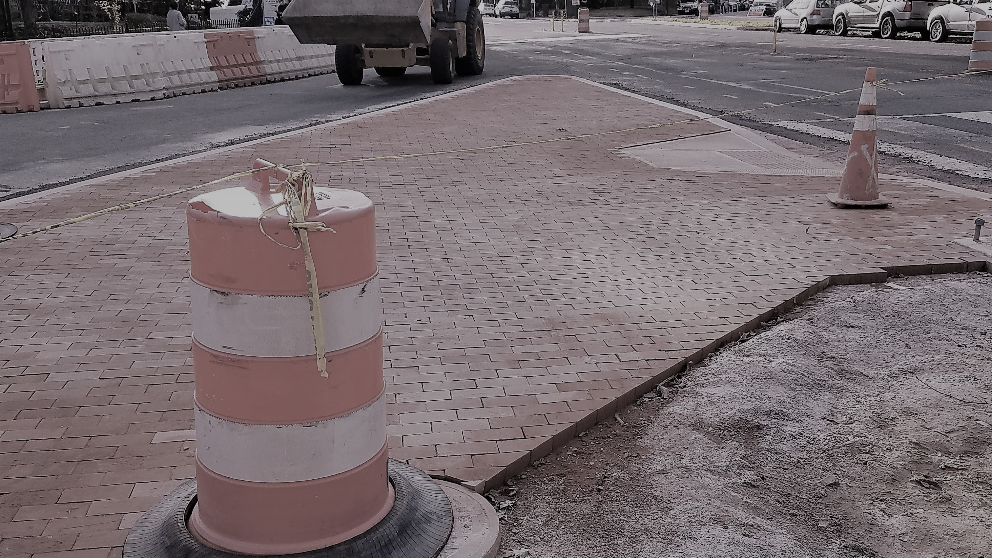
DDOT Construction Phasing
2019/2021
2020/2021
Utility Phasing
Bump outs, Brick Sidewalk, Curb, Gutter, Milling / Overlay, Pavement Marking

Slide 8
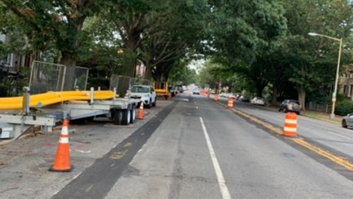
Washington Gas Construction Phasing
2019/2020
2020/2021
Completed: Maryland Ave, Outbound: Gas main & Services Replacement
On going Maryland Ave, Inbound: Gas main & Services Replacement

Slide 9
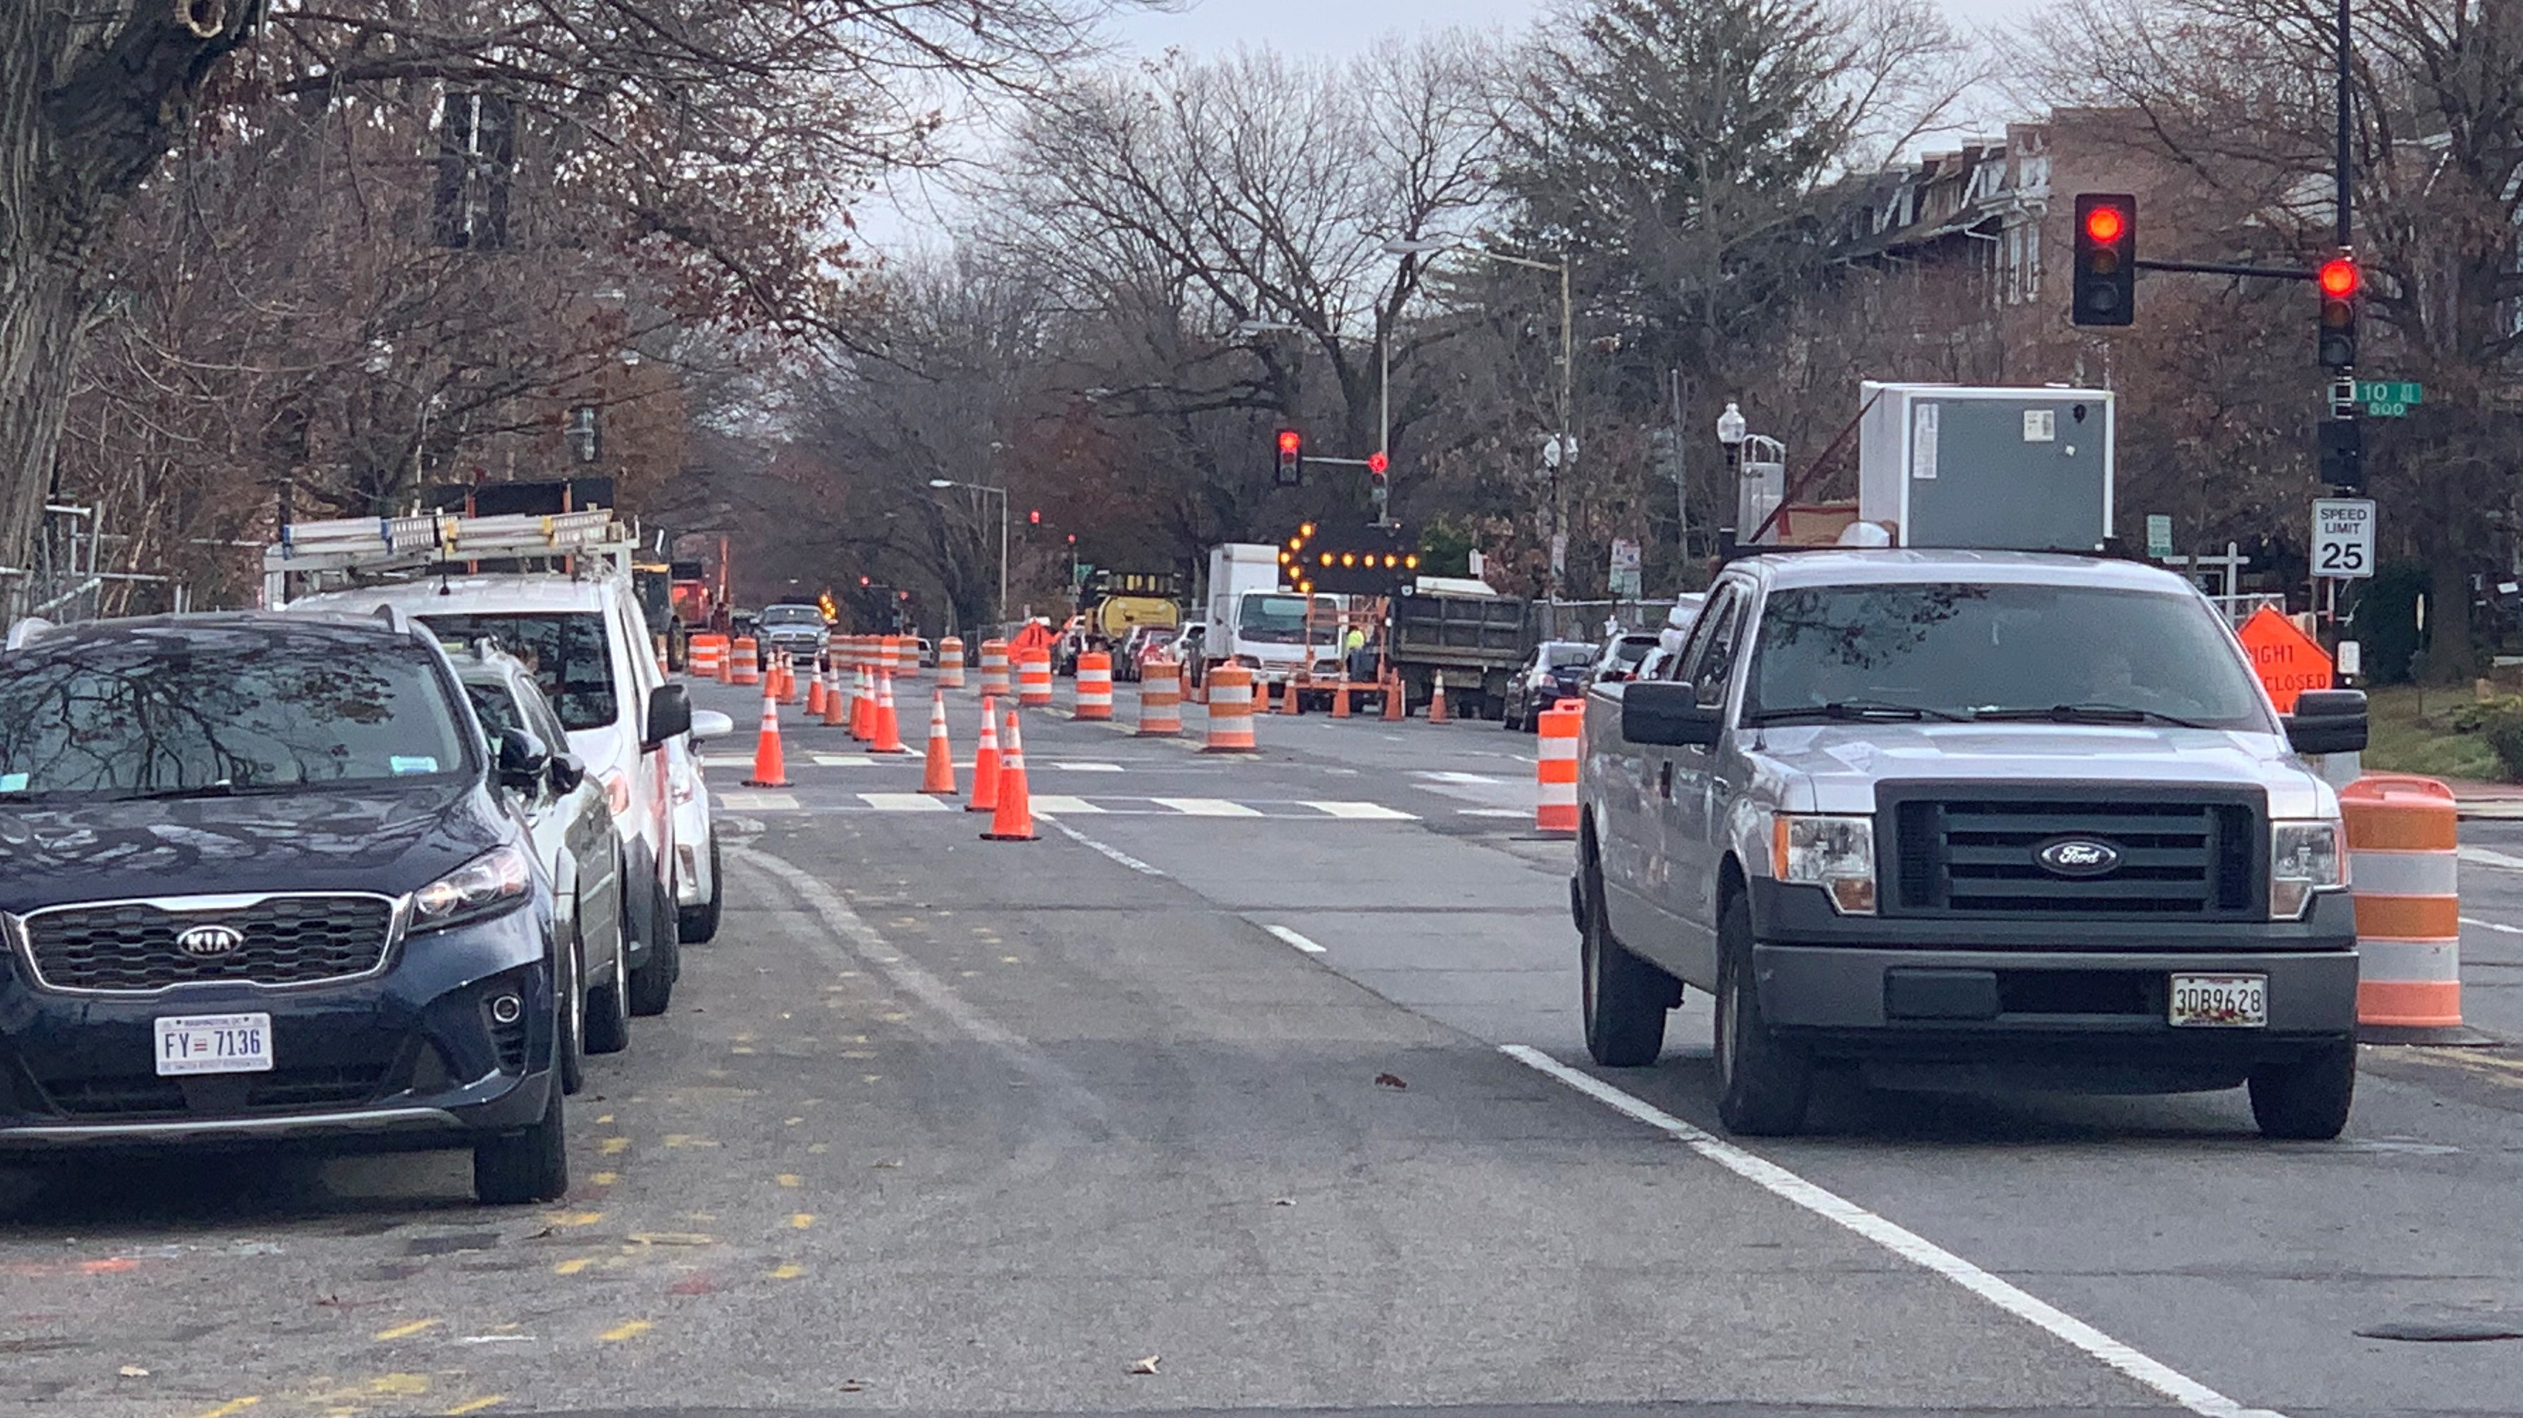
Current Status
Complete
DDOT Utility Phasing inbound
Roadway work: Bump outs, Brick Sidewalk, Granite Curbs, and Bus pads
Not Started
Milling & Overlay
Pavement Markings
In Progress
Utility Phase outbound lanes
Signalization

Slide 10
Contact Us
Project Email
marylandaveneproject@gmail.com
Website
www.marylandavesafety.org
Immediate Issues
Outreach Coordinator: Donica McNeill Tylor/ 202-390-5582
DDOT Project Manager: Abdullahi Mohamed/ 202-531-7563
CM Project Manager: Nandlal Gevaria / 443-535-2325

